Slide 1


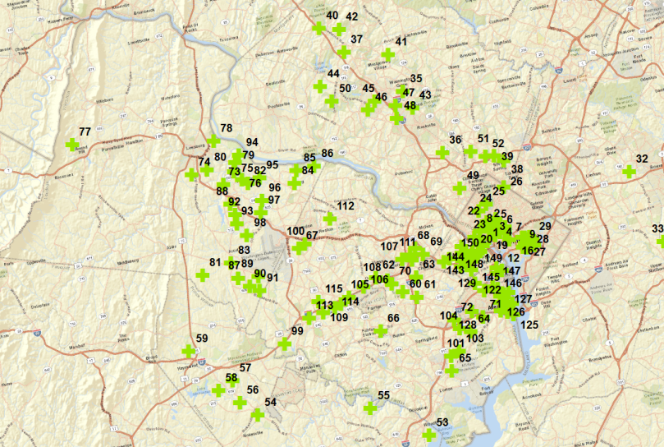
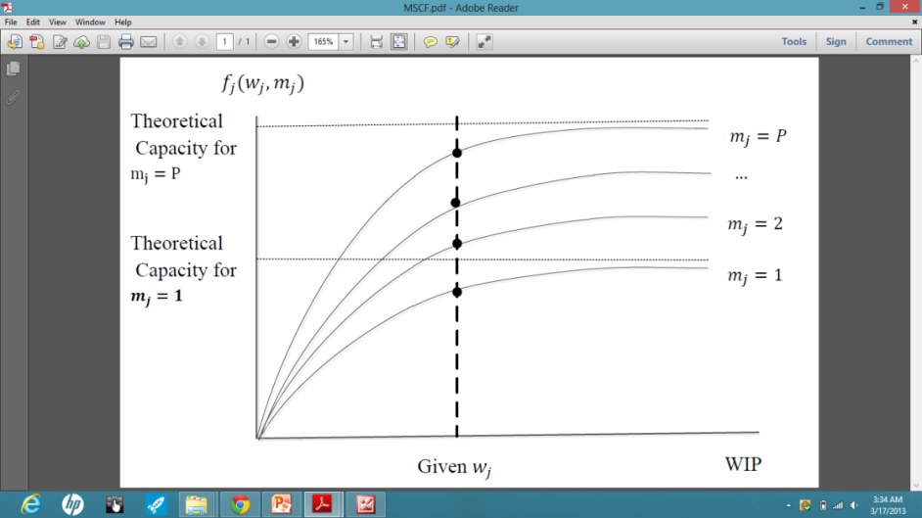
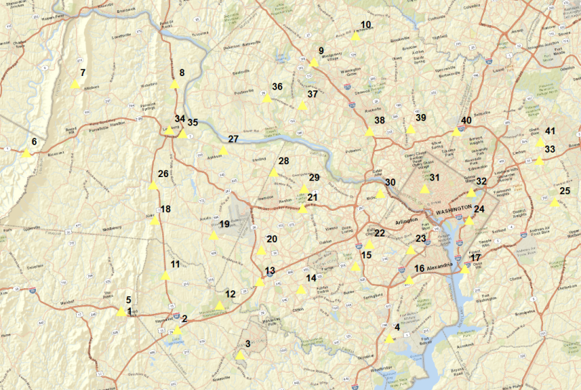
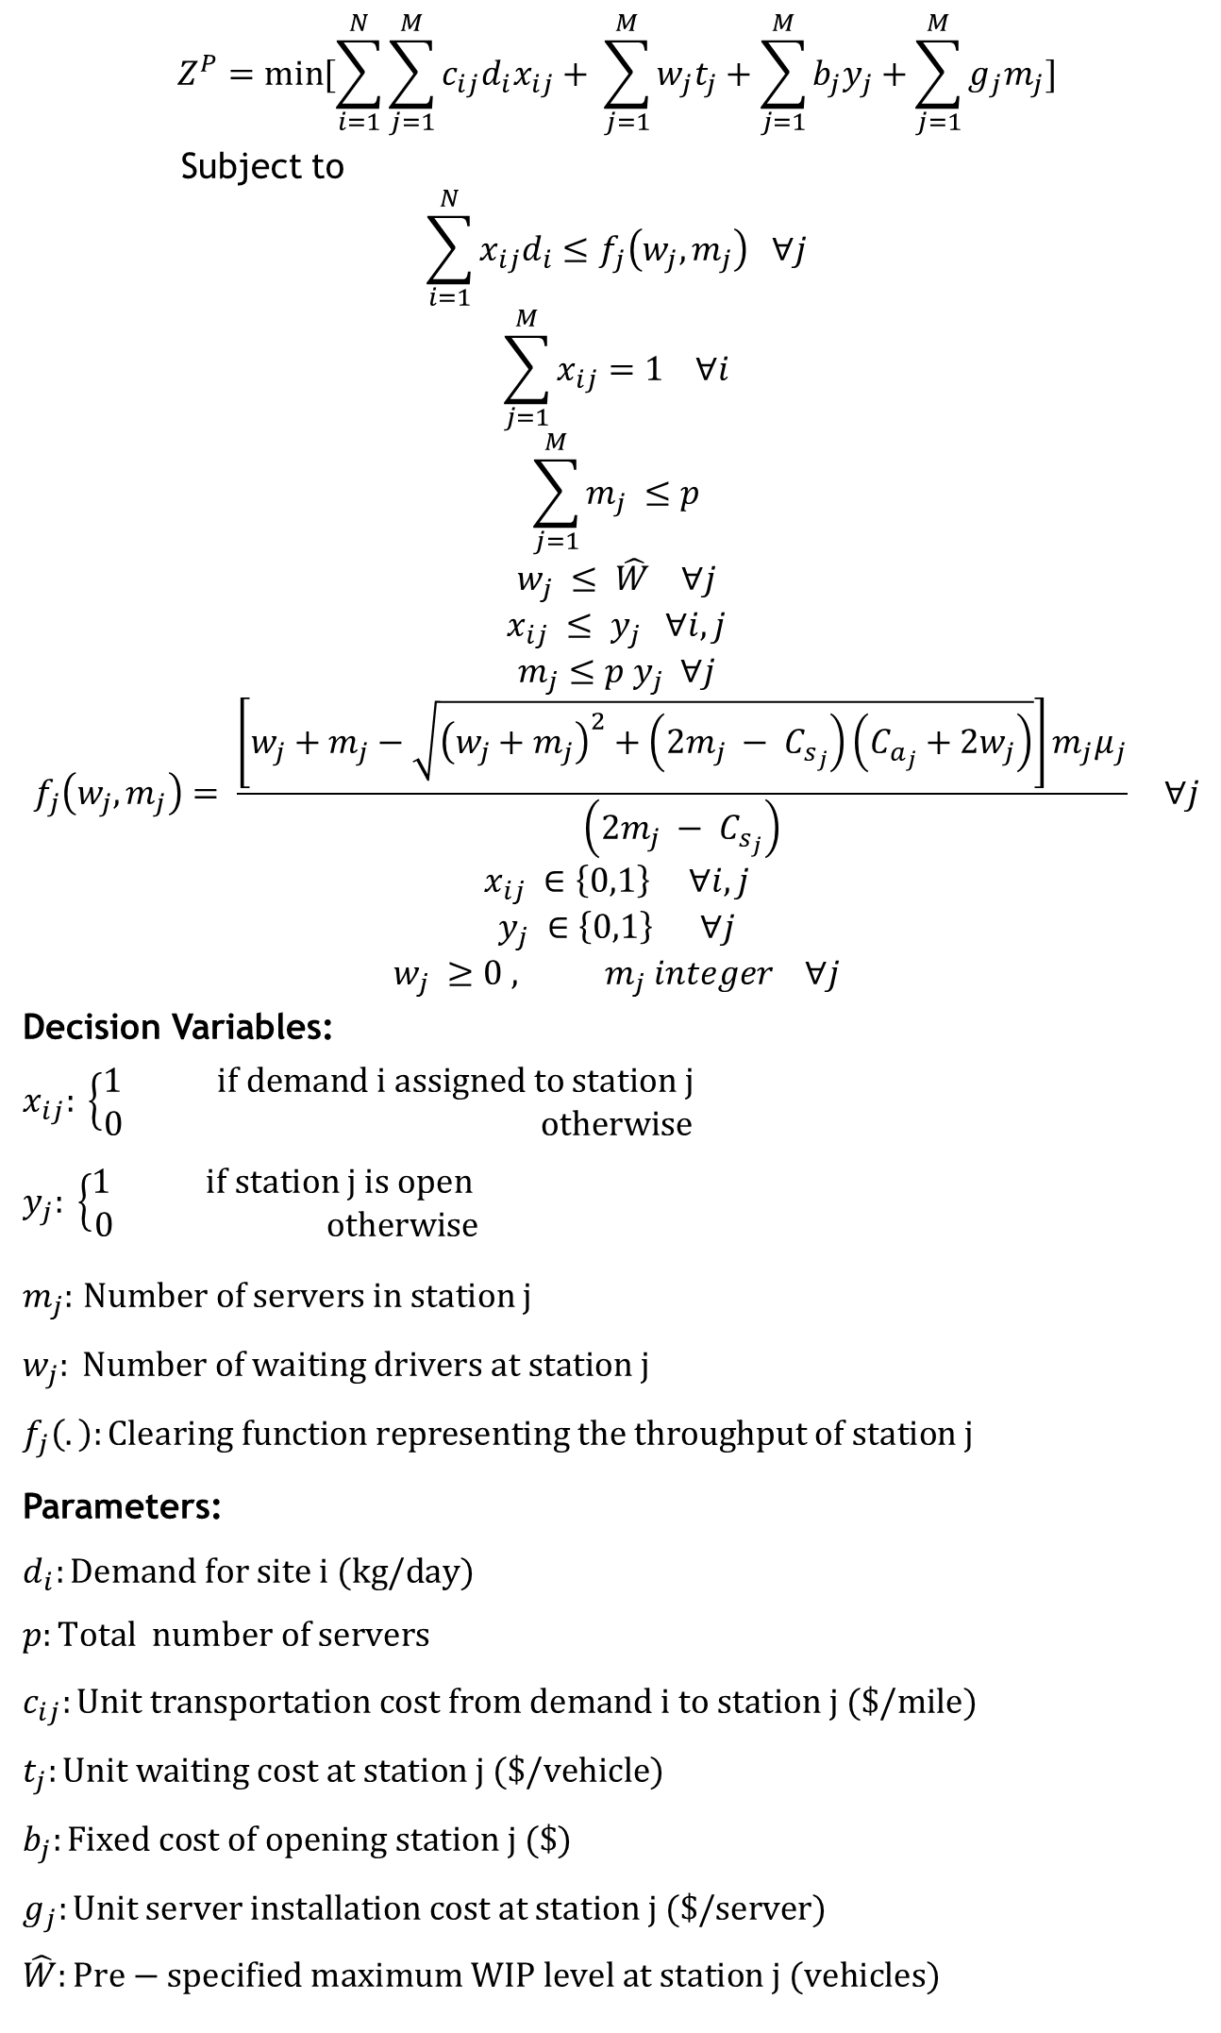
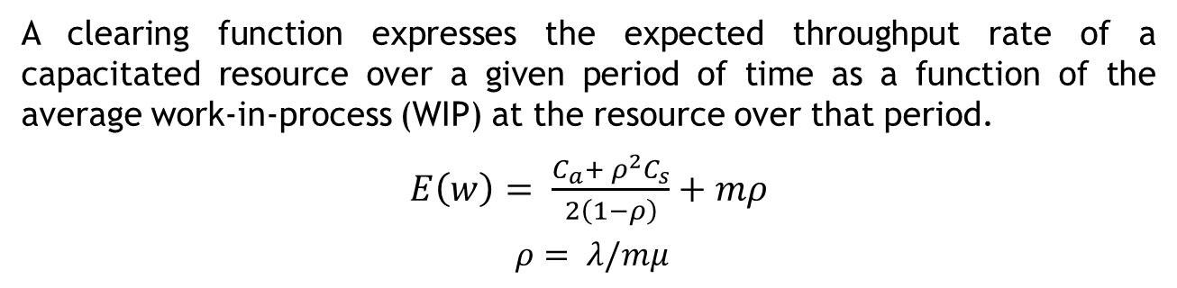
A Multiple Stage Optimization for Developing Hydrogen Refueling Infrastructures in the Northeastern United States
Hossein Abdollahnejadbarough & Kevin B. Martin
Dept of Industrial and Systems Engineering & Dept of Technology/ESE Institute, Northern Illinois University
Abstract
Stochastic Demand Modeling
Mathematical Model
Numerical Results
According to the U.S. Energy Information Administration, the United States consumed approximately 134 billion gallons of gasoline at a national average retail price of $3.52 per gallon for unleaded regular grade gasoline in 2011. A vast majority of this fuel was consumed by the 245 million U.S. registered automobiles and trucks that are included in the transportation sector which overall accounts for 27% of all U.S. greenhouse gas emissions. Hydrogen is a transformational energy carrier which can be domestically produced, lead to dramatic reductions in greenhouse gas emissions, and is approaching comparable prices with traditional fuels. However, the introduction of hydrogen as a vehicular fuel will require the design and development of a comprehensive refueling infrastructure network. An initial hydrogen vehicle supply network for the Northeastern U.S. is designed which includes the metropolitan areas of Boston, Philadelphia, Washington D.C. and New York City. A new formulation for modeling the congestion and capacity of the refueling stations along with strong heuristics and exact solution methods is presented. Stochastic demands are extracted from U.S. census tract data using predictive analytics and Geographical Information System (GIS) methodologies.
U.S. census tracts were analyzed using a Geographical Information System (GIS) to identify locations and concentrations of drivers with the following profile of a highly probable purchaser of a hydrogen fuel cell vehicle:
Income level (areas with 2-5 times the metro area median income)
Education level (2.5 times number of graduate degrees than the local metro area)
Age (45-54 years old and drive alone )
Means of transportation to work ( geographic center of each tract)
Potential hydrogen refueling stations locations are required to be within:
High demand census tracts
2 kilometers of a highway (facilitate refueling station network connections).
$$Z^{P}=\min{[\sum_{i=1}^{N}{\sum_{j=1}^{M}{c_{ij}d_{i}x_{ij}}}+ \sum_{j=1}^{M}{w_{j}t_{j}}+\sum_{j=1}^{M}{b_{j}y_{j}}+\sum_{j=1}^{M}{g_{j}m_{j}}]}$$
Subject to
$$\sum_{i=1}^{N}{x_{ij}d_{i}}≤f_{j}\left(w_{j}, m_{j}\right) ∀j$$
$$\sum_{j=1}^{M}{x_{ij}}=1 ∀i$$
$$\sum_{j=1}^{M}{m_{j}} ≤p$$
$$w_{j} ≤ \hat{W} ∀j$$
$$x_{ij} ≤ y_{j} ∀i,j$$
$$m_{j}≤p y_{j} ∀j$$
$$f_{j}\left(w_{j}, m_{j}\right)= \frac{\left[w_{j}+m_{j}−\sqrt{{\left(w_{j}+m_{j}\right)}^{2}+\left(2m_{j} − C_{s_{j}}\right)\left(C_{a_{j}}+2w_{j}\right)}\right]m_{j}μ_{j}}{\left(2m_{j} − C_{s_{j}}\right)} ∀j$$
$$x_{ij} ∈\left\{0,1\right\} ∀i,j$$
$$y_{j} ∈\left\{0,1\right\} ∀j$$
$$w_{j} ≥0 , m_{j} integer ∀j$$
Decision Variables:
$x_{ij}: \left\{\begin{aligned}1 if demand i assigned to station j \\ 0 otherwise\end{aligned}\right.$
$$y_{j}: \left\{\begin{aligned}1 if station j is open \\ 0 otherwise\end{aligned}\right.$$
$m_{j}:$ $Number of servers in station j$
$$w_{j}: Number of waiting drivers at station j$$
$$f_{j}\left(.\right):\text{Clearing} \text{function} \text{representing} \text{the} \text{throughput} \text{of} \text{station} \text{j}$$
Parameters:
$$d_{i}:\text{D}\text{emand} \text{for} \text{site} \text{i}\text{ (}\text{kg}\text{/}\text{day}\text{)}$$
$$p:Total number of servers$$
$$c_{ij}:\text{U}\text{nit} \text{transportation} \text{cost} \text{from} \text{demand} \text{i} \text{to} \text{station} \text{j}\text{ (\$/}\text{mile}\text{)}$$
$$t_{j}:\text{U}\text{nit} \text{waiting} \text{cost} \text{at} \text{station} \text{j}\text{ (\$/}\text{vehicle}\text{)}$$
$$b_{j}:\text{Fi}\text{xed} \text{cost} \text{of} \text{opening} \text{station} \text{j}\text{ (\$)}$$
$$g_{j}:\text{U}\text{nit} \text{server} \text{installation} \text{cost} \text{at} \text{station} \text{j}\text{ (\$/}\text{server}\text{)}$$
$$\hat{W}:Pre−specified maximum WIP level at station j (vehicles)$$
Table 1. Problem sizes for different cities
City | # of Demand Points | # of Feasible Locations | Forecasted Demand (kg/day)
Boston | 88 | 40 | 3588.86
Philadelphia | 145 | 64 | 9113.28
New York City | 293 | 84 | 5851.29
Washington D.C. | 150 | 41 | 7384.13
Table 2. Total costs of establishing the refueling stations in different cities, duality gaps and CPU Times
City | # of Stations | Total Investment Cost($) | Duality Gap (%) | CPU Time (Sec.)
Boston | 28 | 33,585,000 | 4.93 | 201.81
Philadelphia | 28 | 78,314,800 | 0.00 | 5288.07
New York City | 66 | 62,379,400 | 1.00 | 491.02
Washington D.C. | 27 | 53,761,600 | 2.40 | 1361.30
Clearing Function
A clearing function expresses the expected throughput rate of a capacitated resource over a given period of time as a function of the average work-in-process (WIP) at the resource over that period.
$E\left(w\right)= \frac{C_{a}+ ρ^{2}C_{s}}{2\left(1−ρ\right)}+mρ$
$ρ= λ/mμ$
Discrete Event Simulation
Table 3. The DES results for the performance of the refueling stations
City | Network utilization rate (%) | Avg. # of waiting vehicles in city
Boston | 66.42 | 21.46
Philadelphia | 37.47 | 21.14
New York City | 68.22 | 49.45
Washington D.C. | 60.00 | 20.30
Figure 2. Washington D.C. demand identification
Acknowledgments
This presentation is sponsored by INFORMS PC Committee .
Contacts
Hossein Abdollahnejadbarough
M.Sc. In Industrial and Systems Engineering
Email: hossein.abdolahnejad@gmail.com
Phone: (815) 508-8817
Figure 1. A Multiple Server Clearing Function
Figure 3. Washington D.C. feasible location

